Slide 1


Credit Exploratory Data Analysis Assignment
Prepared By – Surya Verma
May – 2023 Batch

Slide 2
Business Objectives
This case study aims to identify patterns that indicate if a client has difficulty paying their installments which may be used for taking actions such as denying the loan, reducing the amount of the loan, lending (to risky applicants) at a higher interest rate, etc. This will ensure that the consumers capable of repaying the loan are not rejected. Identification of such applicants using EDA is the aim of this case study.
In other words, the company wants to understand the driving factors (or driver variables) behind loan default, i.e. the variables which are strong indicators of default. The company can utilize this knowledge for its portfolio and risk assessment. To develop your understanding of the domain, you are advised to independently research a little about risk analytics - understanding the types of variables and their significance should be enough.

Slide 3
Business Understanding :
The data given below contains information about the loan application at the time of applying for the loan. It contains two types of scenarios:
The client with payment difficulties: he/she had a late payment of more than X days on at least one of the first Y installments of the loan in our sample,
All other cases: All other cases when the payment is paid on time.
When a client applies for a loan, four types of decisions could be taken by the client/company):
Approved: The Company has approved the loan application
Canceled: The client canceled the application sometime during approval. Either the client changed her/his mind about the loan or in some cases due to a higher risk of the client, he received worse pricing which he did not want.
Refused: The company had rejected the loan (because the client does not meet their requirements etc.).
Unused offer: The loan has been canceled by the client but is at different stages of the process.
In this case study, you will use EDA to understand how consumer attributes and loan attributes influence the tendency to default.

Slide 4
Analysis as per the Requirement
Analysis on Application Data
Analysis on Previous App Data
Outlier Detection
Number of Children
Analysis Years_Employed Columns
Analysing Amt_Req_Credit
Univariate Analysis
Occupation Type
Organization Type Frequency
Analyzing Categorical Variables(F/P)
Analyzing Categorical Variables(Payment /Non Payment Difficulties)
Checking Imbalance
Bivariate Analysis
Loan Application By Gender and Credit Range
Income Vs Credit (Payment / Non Payment
Numerical Vs Numerical Variables
Multivariate Analysis
Correlation Btw Target 0 & Target 1
Matrix for Non - Payment Difficulties
Matrix for Payment Difficulties
Univariate Analysis
Analyzing Categorical Variables (F/P)
Approved Loans
Analyzing Categorical Variables (F/P)
Refused Loan
Analyzing Categorical Variables (F/P)
Merging Application & Previous Application Data
Name Contract Status Vs Name Contract Type
Name Contract Status Vs Name Client Type
Name Contract Status Vs Code Gender
Name Contract Status Vs Name Education Type
Name Contract Status Vs Occupation Type
Name Contract Status Vs Product Combination
Name Contract Status Vs Amt Income Total

Slide 5
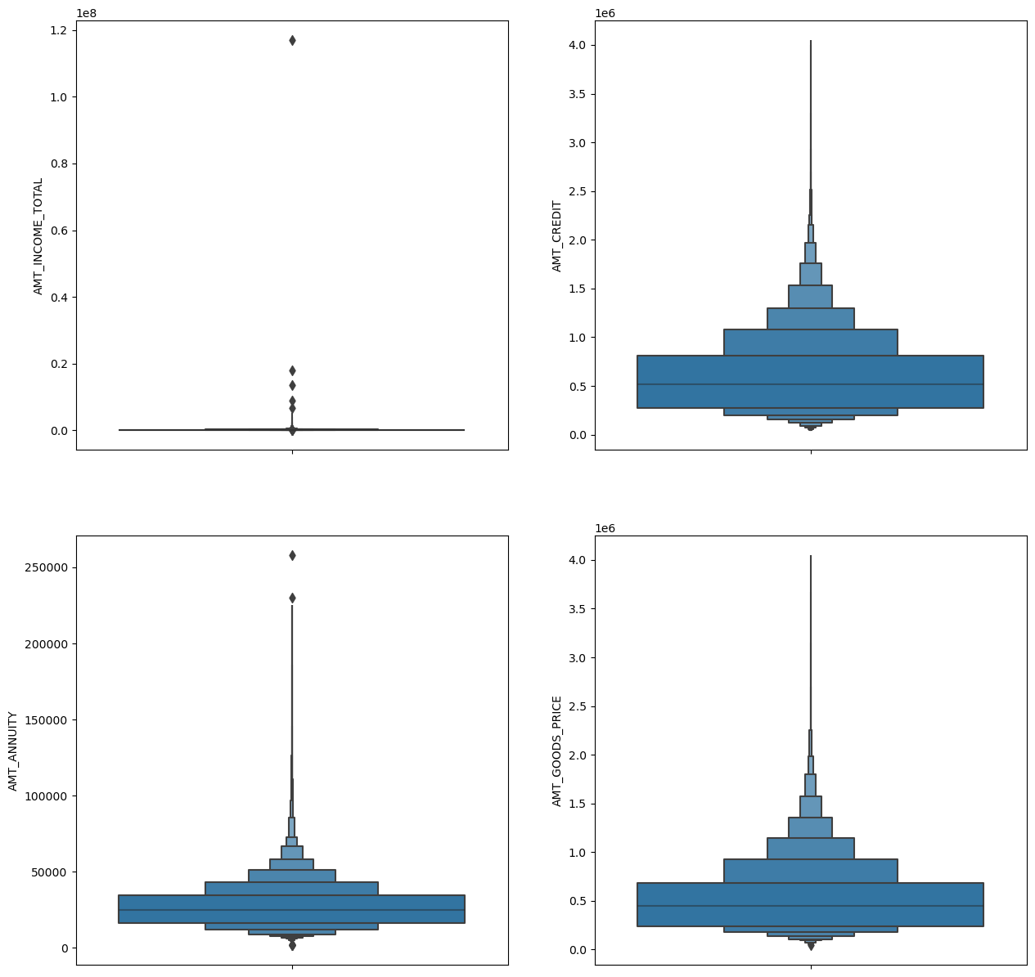
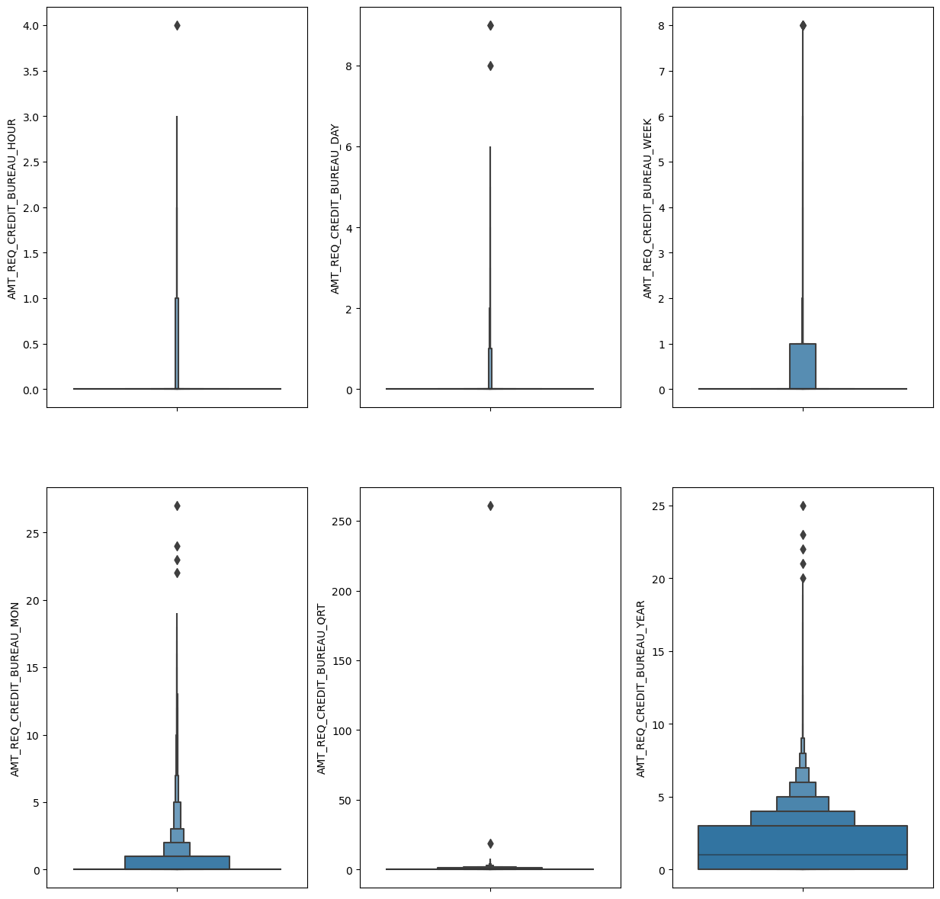
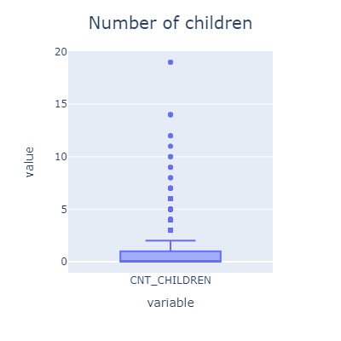
Analysis on Application Data
Outlier Detection
Analysis Years_Employed Columns
Analyzing Amt_Req_Credit

Slide 6
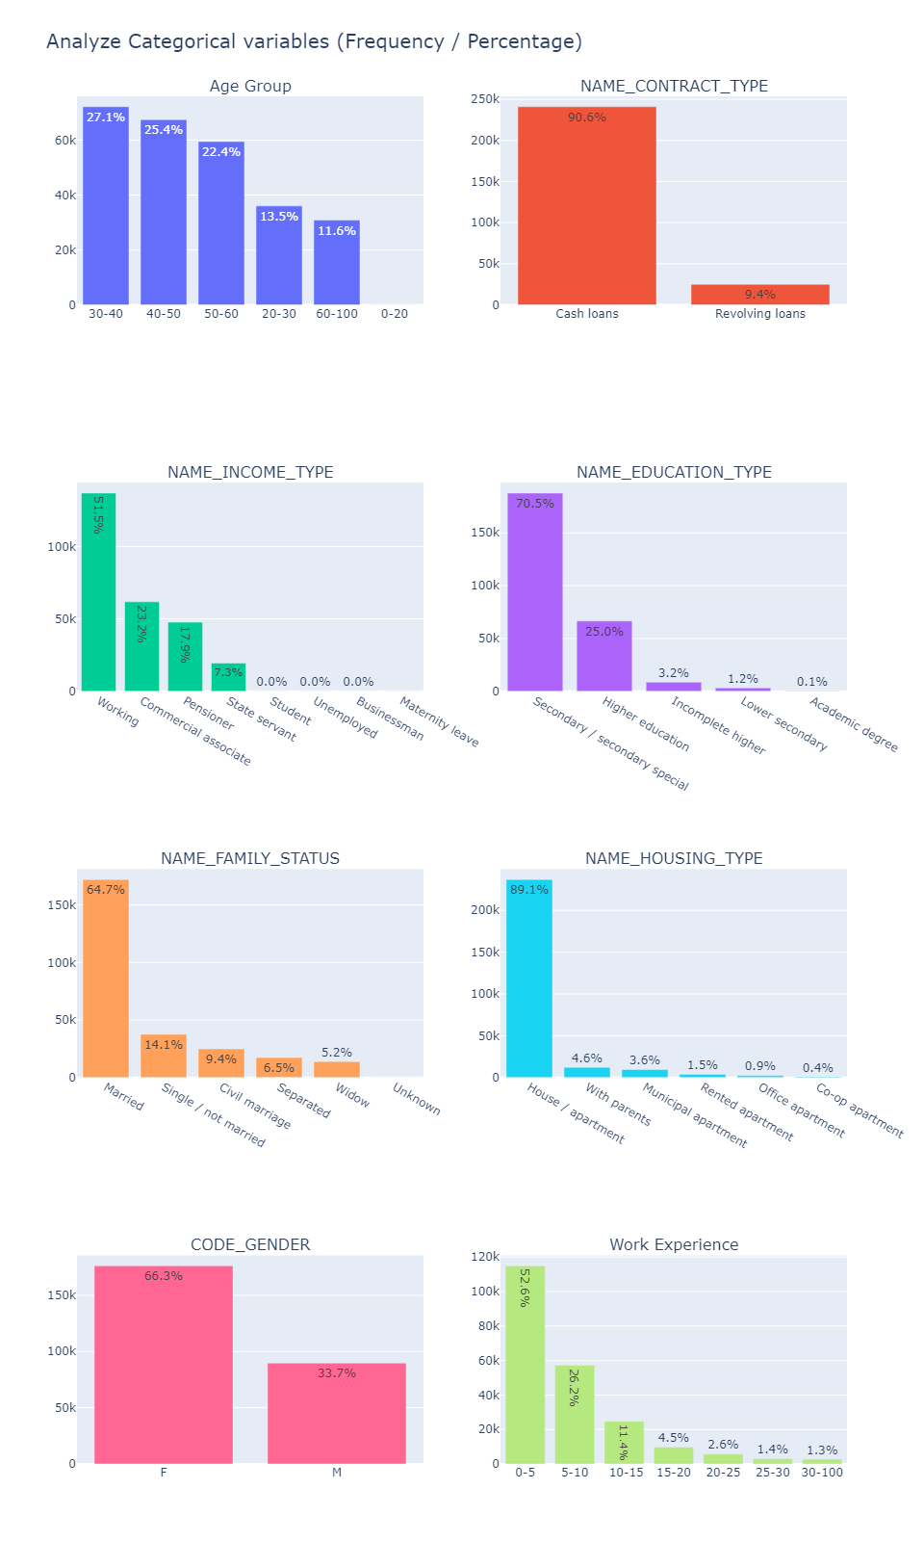
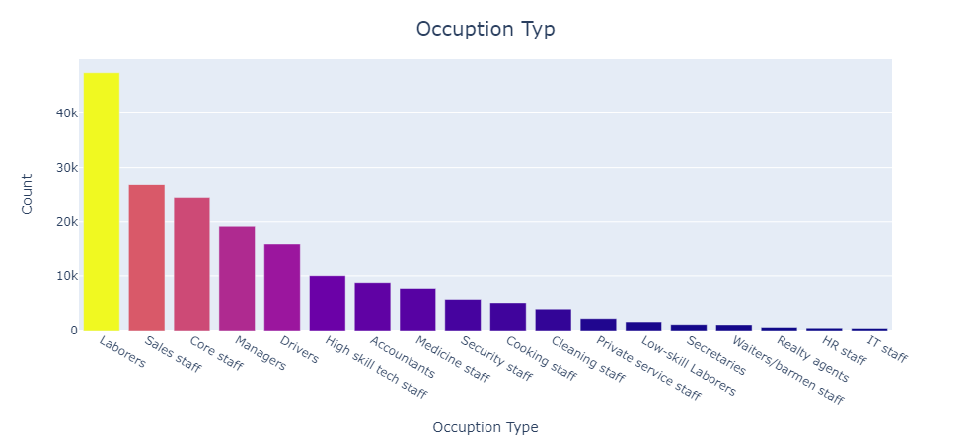
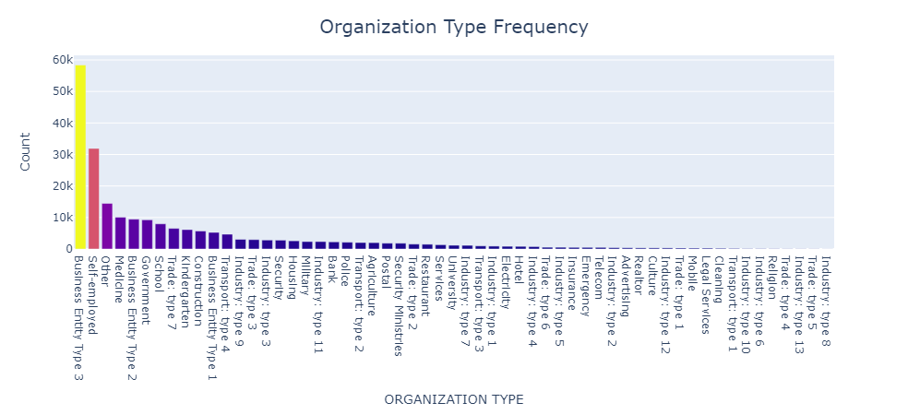
Univariate Analysis

Slide 7
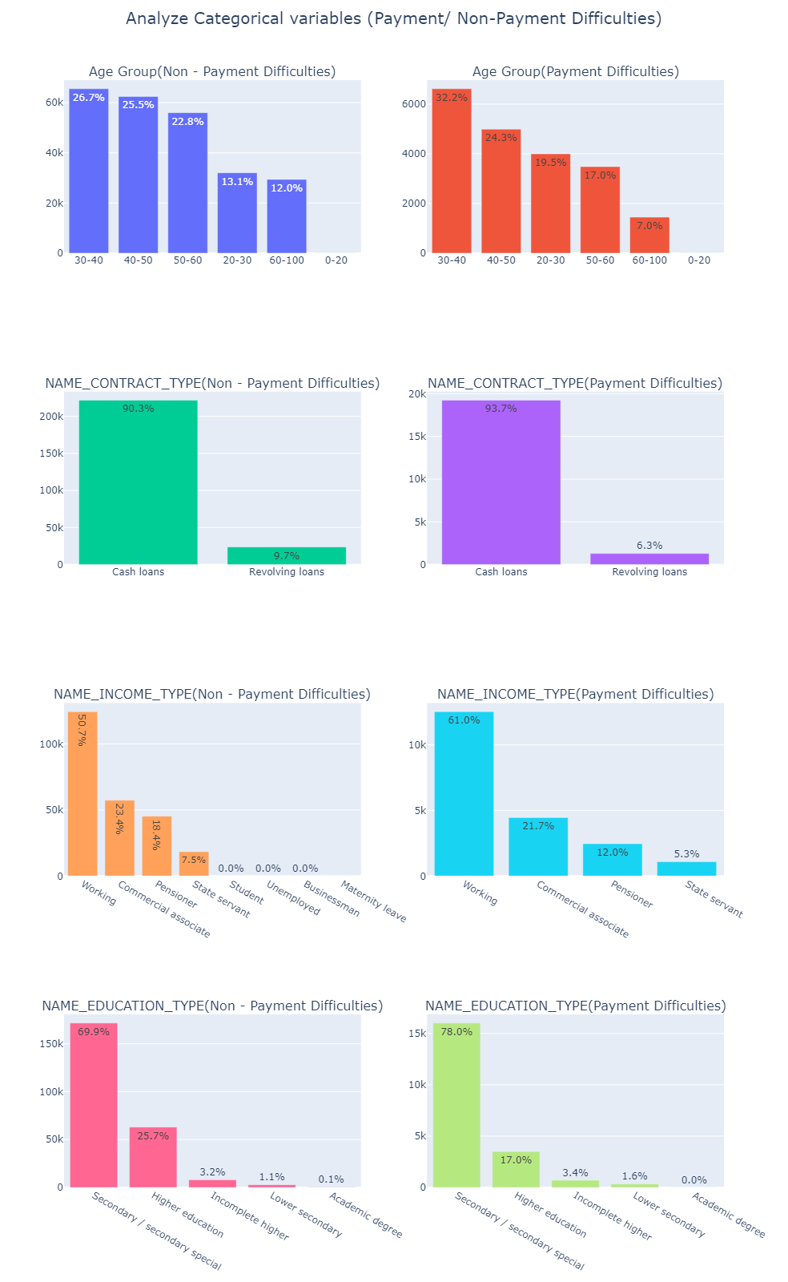
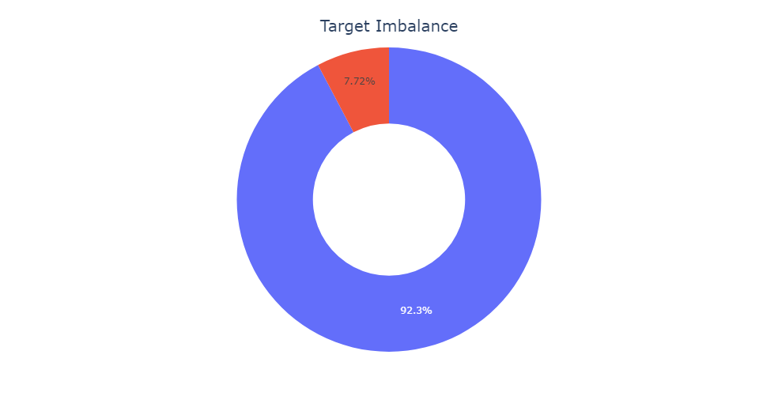
Univariate Analysis

Slide 8
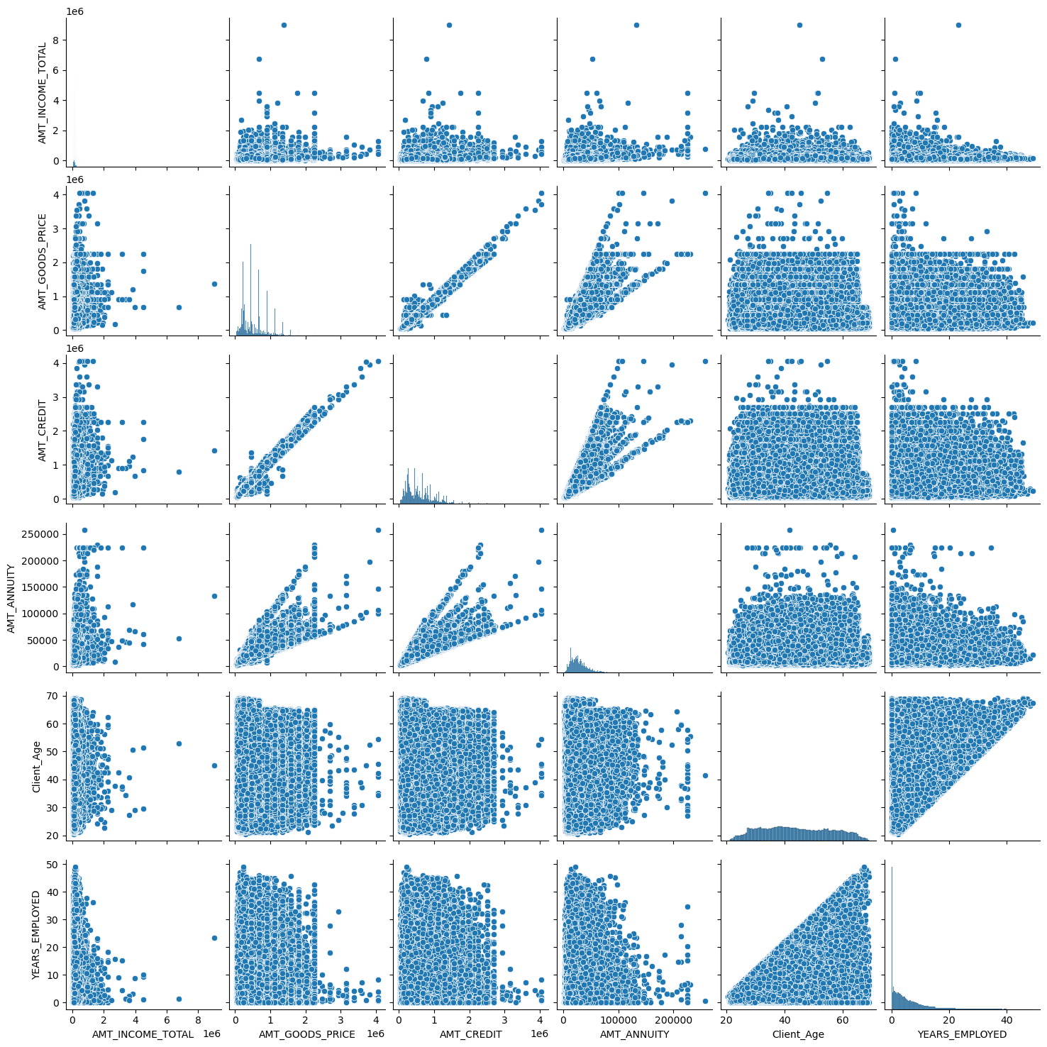
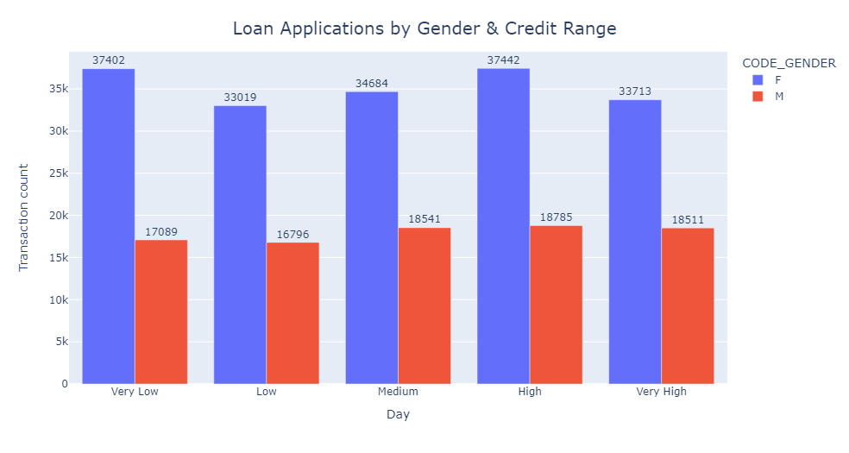
Bivariate Analysis
Numerical Vs Numerical Variables

Slide 9
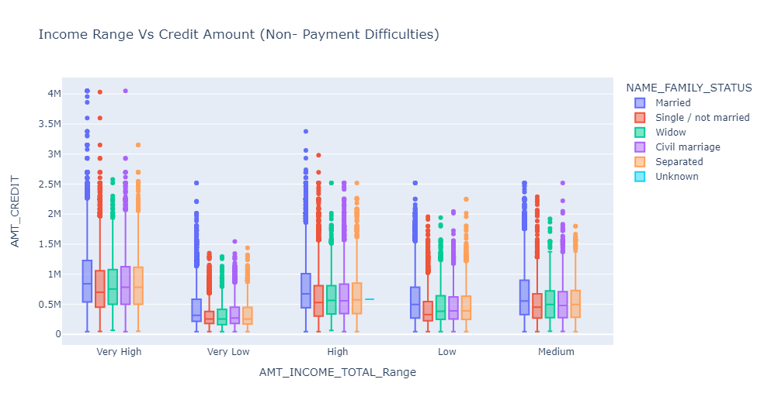
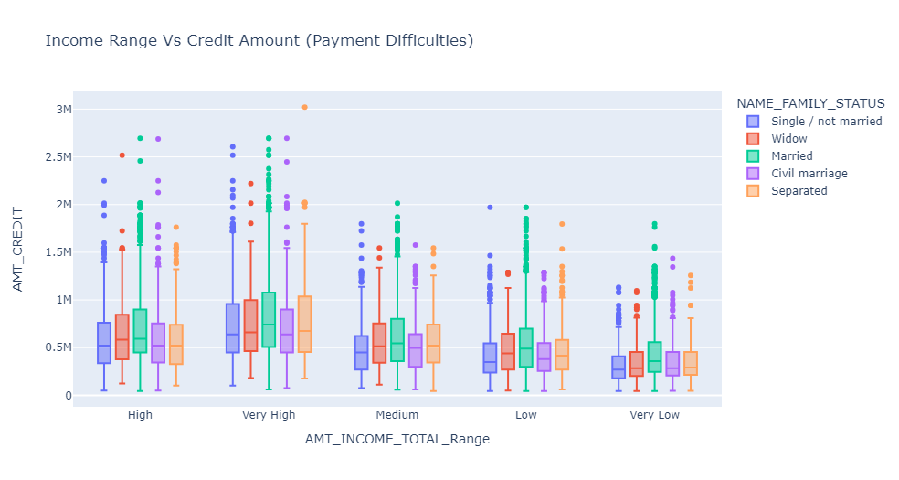
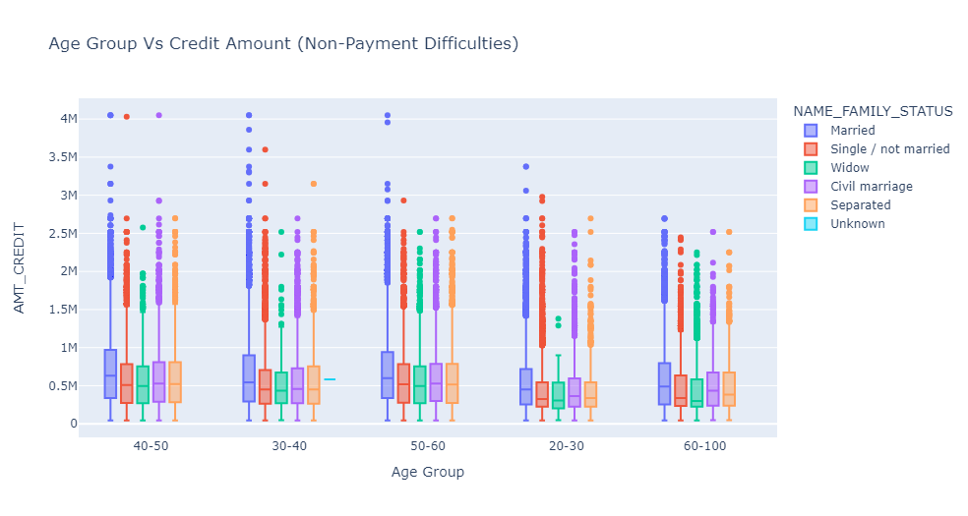
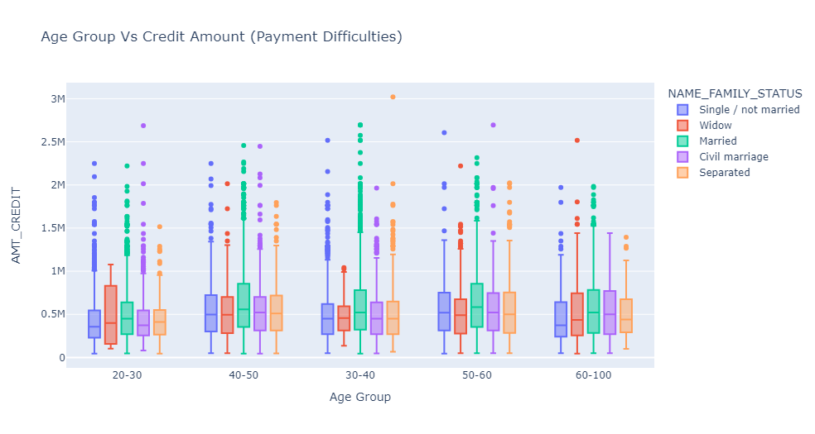

Slide 10
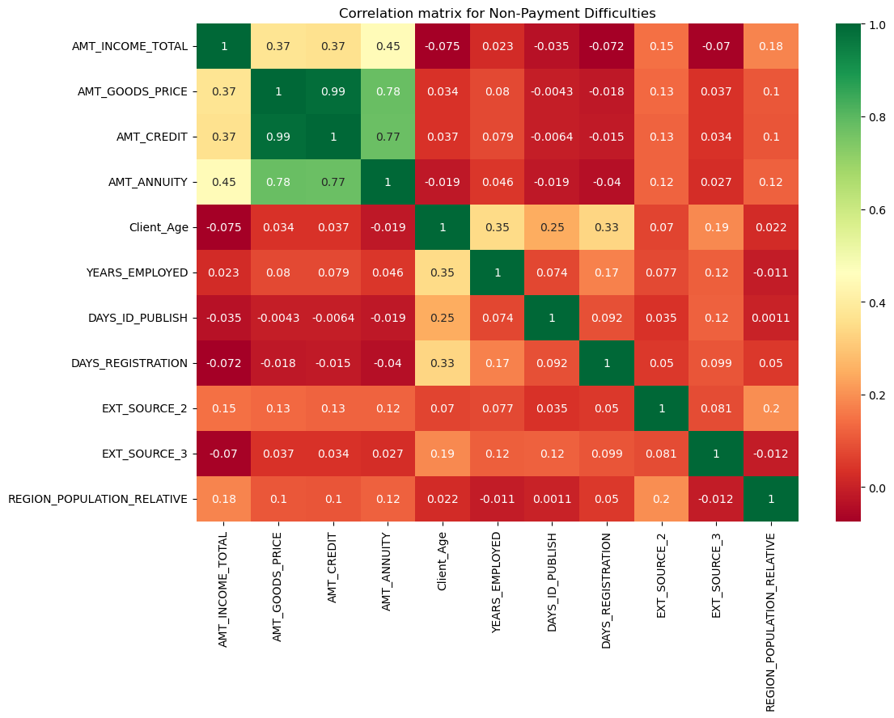
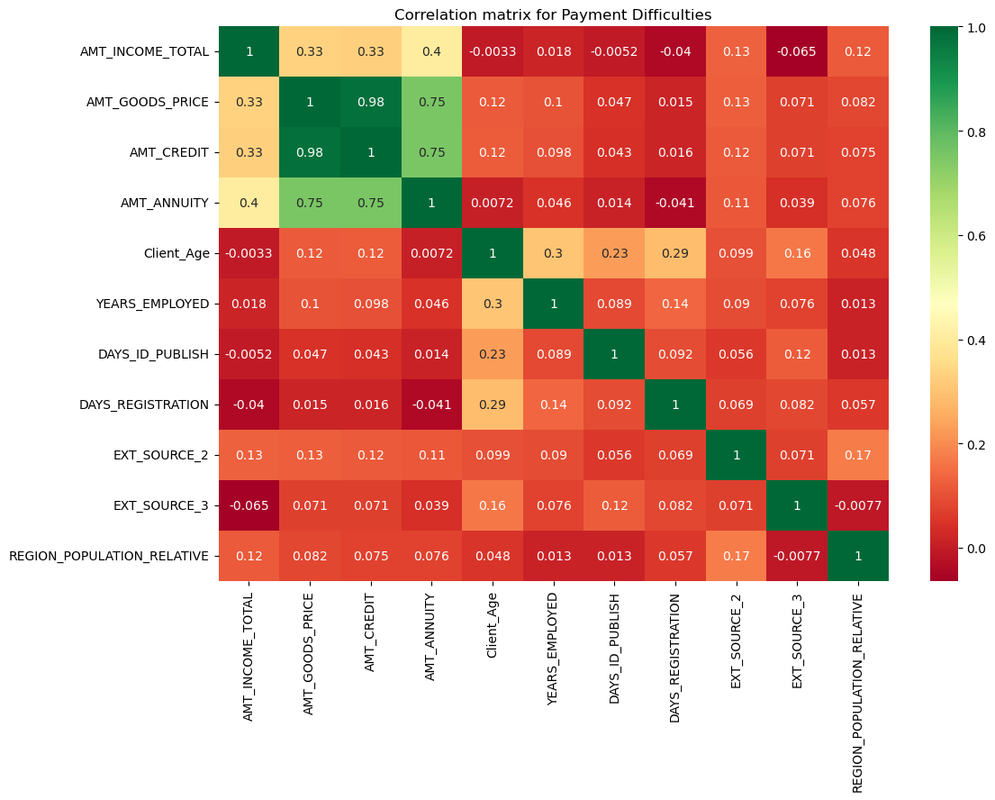
Multivariate Analysis

Slide 11
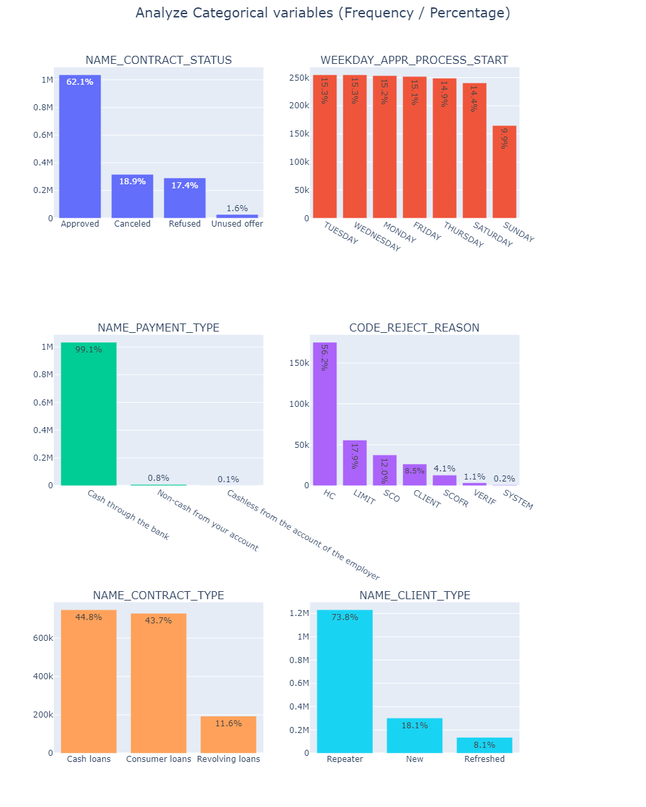
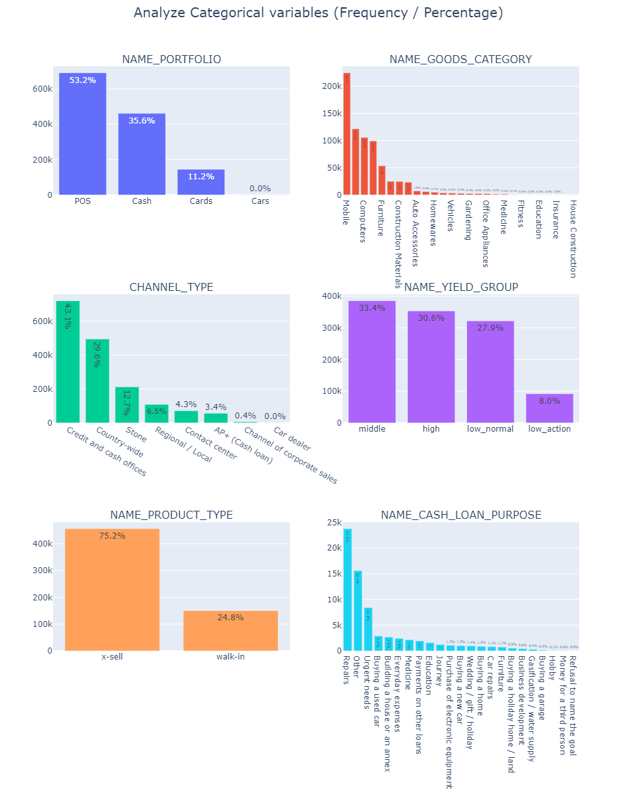
Analysis on Previous App Data
Univariate Analysis

Slide 12
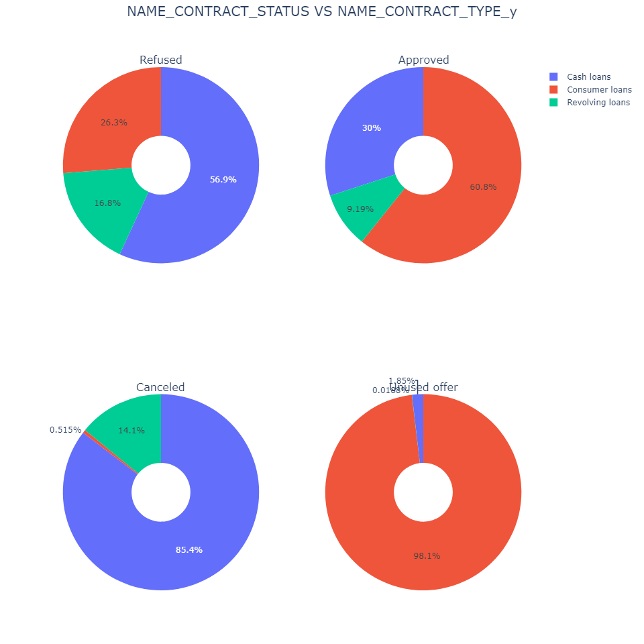
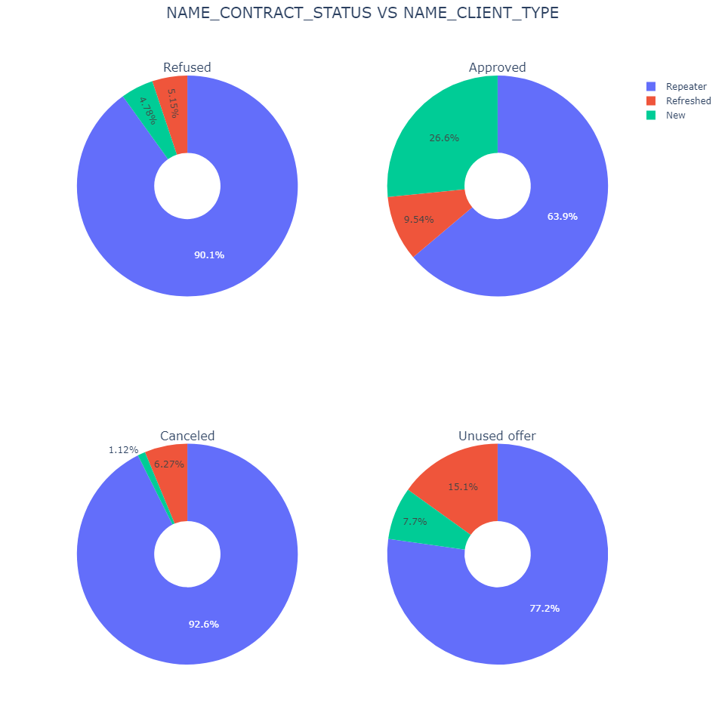
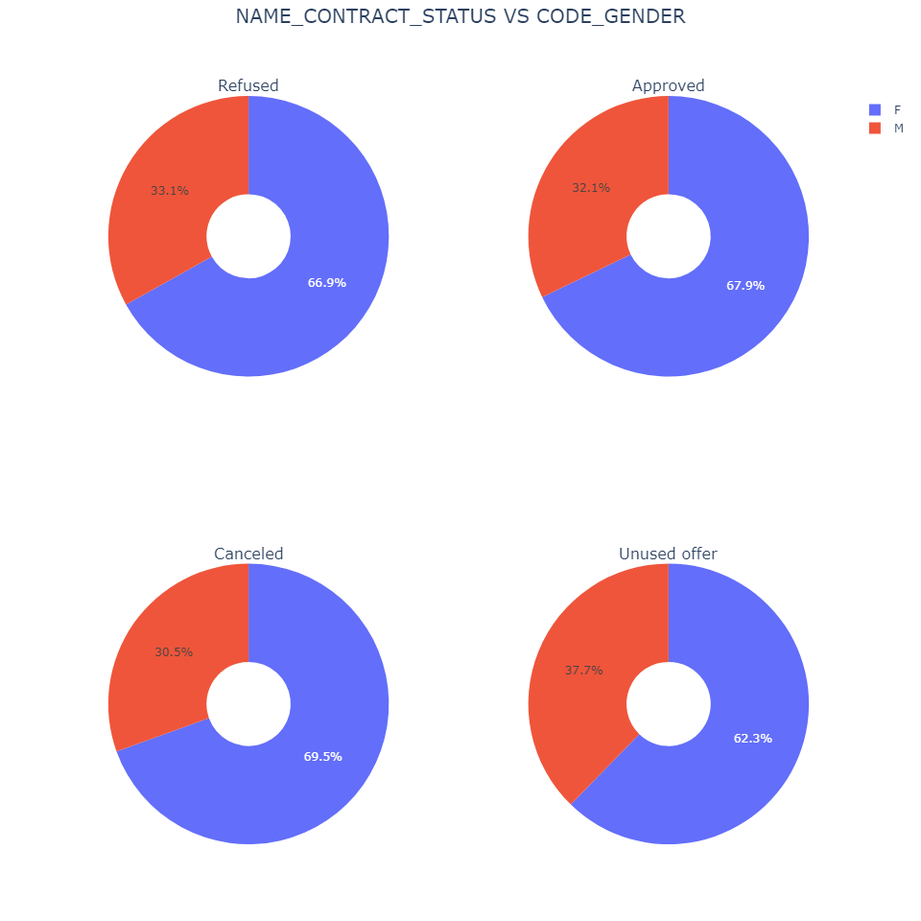
Merging Application & Previous Application Data

Slide 13
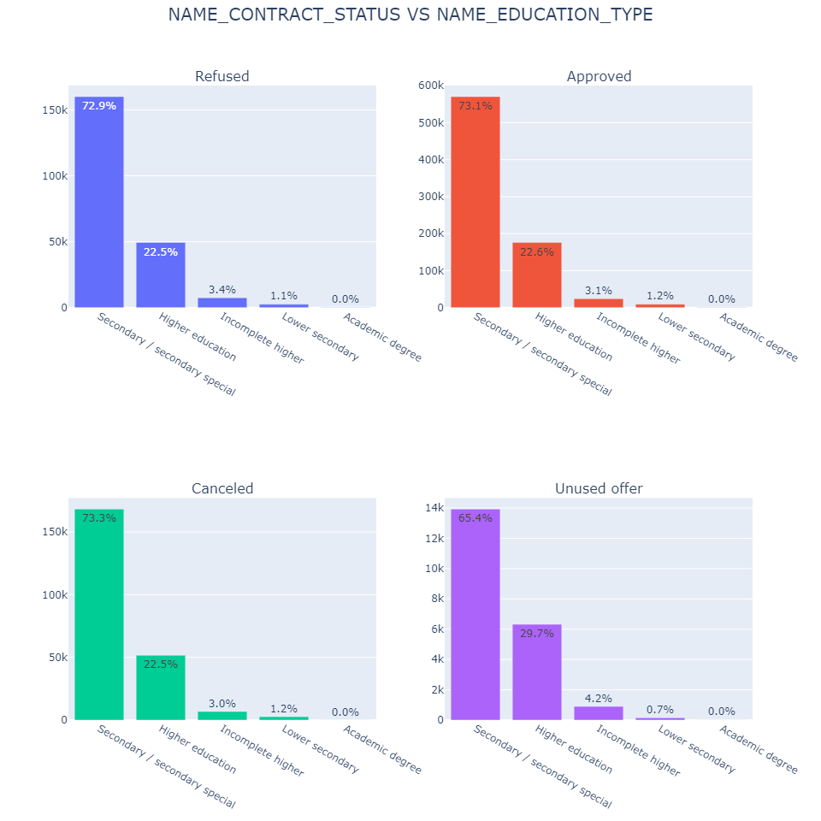
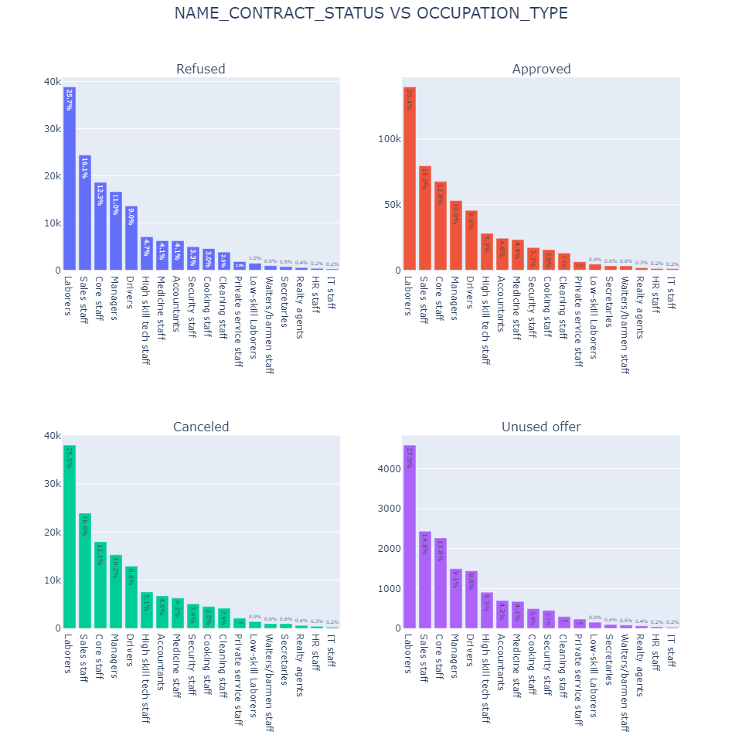

Slide 14
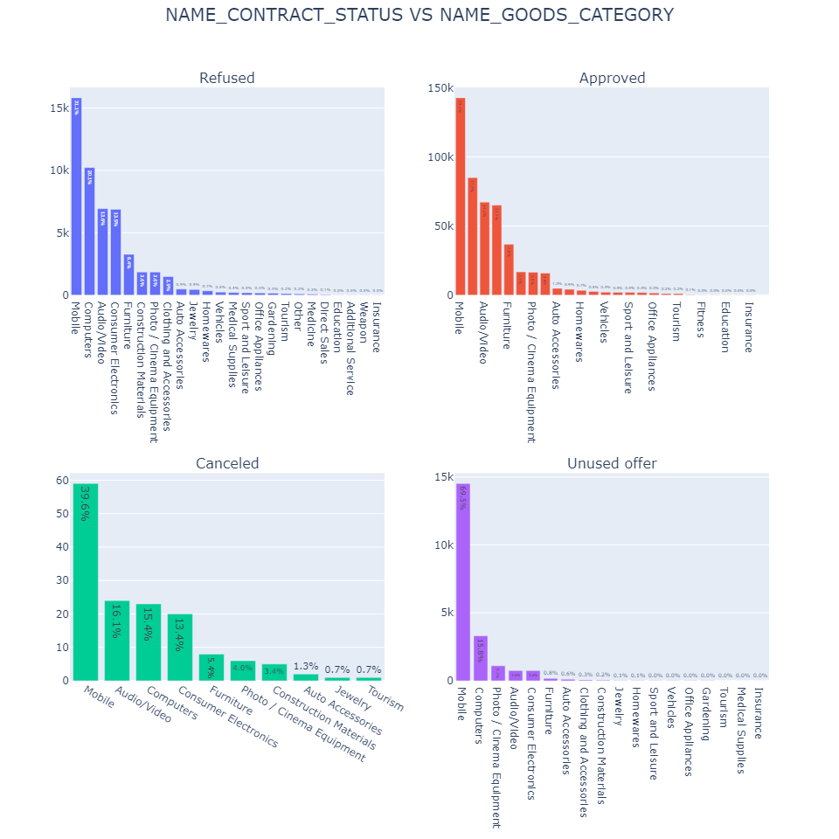
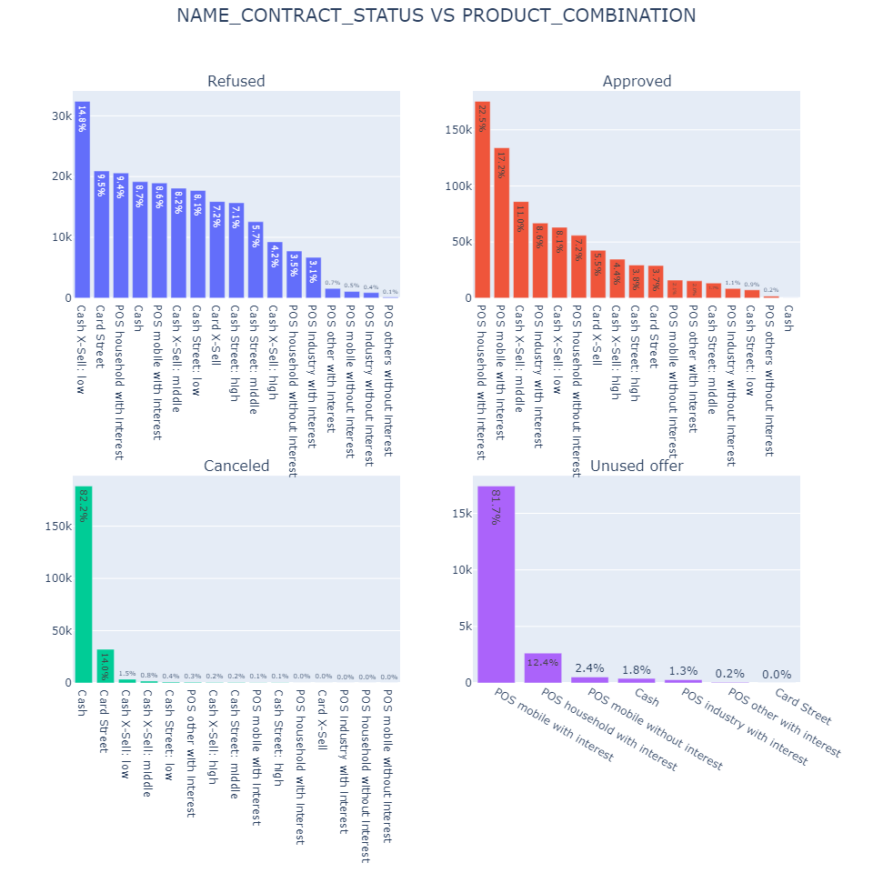

Slide 15
